Slide 1
CPE 133
Review of Previous Examples (#1, #4, #7)
More FSM-Based Counter Examples

Slide 2
Finite State Machines (FSMs)
Primarily used as controller circuits
FSMs as counters good for learning
Nicely modeled with state diagrams
Approach
Same basic counter with added features in each example
All examples from Chapter 23

Slide 3
Design Example #1
Using the diagram below, design a FSM that implements a 2-bit binary counter. The counter’s increments are synchronized with the rising-edge of the CLK input. This counter counts endlessly using this sequence in binary: …0,1,2,3,0,1,…
Provide a circuit diagram
Provide a state diagram

Slide 4
Timing Diagram: Example #1

Slide 5
Design Example #4
Using the diagram on the right, design a FSM that implements a synchronous (RET) 2-bit binary up counter. This counter counts up when the CE (count enable) input is a ‘1’ and holds the previous count when the CE signal is ‘0’. Provide both a circuit diagram and state diagram for your solution.
Provide a circuit diagram
Provide a state diagram

Slide 6
Timing Diagram: Example #4

Slide 7
Design Example #7
Using the diagram on the right, design a FSM that implements a synchronous 3-bit stoneage binary up counter. The counter also has a positive logic control enable (CE) input that allows the counter to count. Assume the counter increments on the rising clock edge.
Don’t Use more than two bits of storage in your FSM
Provide a circuit diagram
Provide a state diagram

Slide 8
Timing Diagram: Example #7

Slide 9
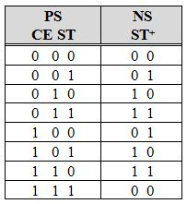
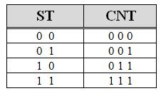
Design #7: Circuit Schematic
Next State Decoder
Output Decoder

Slide 10
Design Example #8
Using the diagram on the right, design a FSM that implements a synchronous 2-bit stoneage binary up counter. The counter also has a control enable (CE, positive logic) input that allows the counter to count up. The counter also contains a “ripple carry out” output signal (RCO) that indicates when the counter is currently outputting it’s maximum count value.
Use only bits of storage in your FSM design.
Provide a circuit diagram
Provide a state diagram

Slide 11
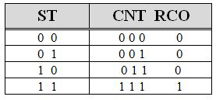
Design #8: State Diagram
Output Decoder Design #7
Output Decoder Design #8

Slide 12
Design #8: Timing Digram

Slide 13
Design Example #9
Using the diagram on the right, design a FSM that implements a synchronous counter that has both a 2-bit binary (BCNT) and a 3-bit stoneage binary (SBCNT) output. The FSM also a count enable input (CE) which serves two functions. When the CE is asserted, both counter outputs increment of the active clock edge. When CE is not asserted, neither count is incremented. Additionally, the binary count (BCNT) outputs “00” when CE is not asserted, but returns to its original value when CE is reasserted. The CE input prevents the counter from changing state but has no effect on SBCNT.
Provide a circuit diagram
Provide a state diagram

Slide 14
Design #9: Solutions
Example #9 Circuit Design
ST CE

Slide 15
Design #9: State Diagram

Slide 16
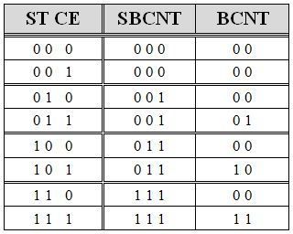
Design #9: Solutions
Output Decoder Design #9

Slide 17
Design #9: Timing Diagram
BCNT: Mealy-type Output: based on state & external input (CE)
SBCNT: Moore-type Output: based on state only

Slide 18
FSM Output Type
Moore Outputs
Only a function of FSM state
Mealy Outputs
Function of FSM state & External Input(s)

